Slide 1
PID Controller & Laplace Domain
Johannes Betz (joebetz@seas.upenn.edu)
Houssam Abbas, Matthew O’Kelly
Lecture #4

Slide 2
Lesson Plan
Part I: Tracking a reference signal
Part II: PID control
Part III: The Laplace transform
Part IV: Applications

Slide 3

Tracking a reference signal
x

Slide 4
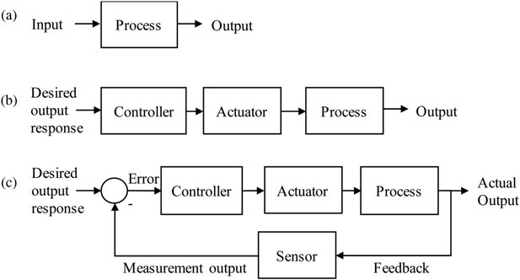
Control Engineering
Control Engineering: We are focusing on modeling a diverse range of dynamic systems (e.g. mechanical system, electrical systems)
We will design controllers that will cause these systems to behave in the desired manner
Source: Researchgate

Slide 5
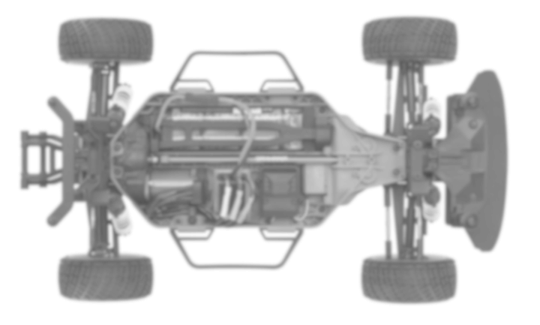
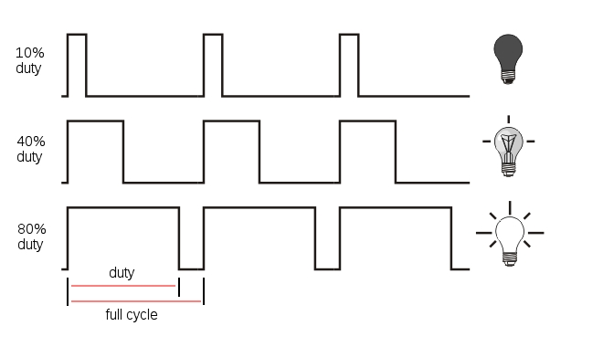
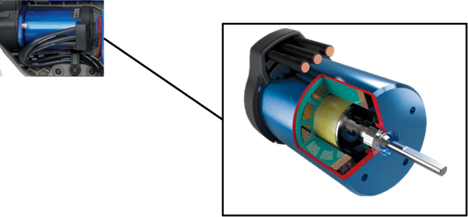
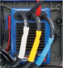
Tracking a Reference Signal: Engine Speed
Controller
Pulse Width-Modulated signals
Motor
Reference Signal:
“60 RPM”

Slide 6
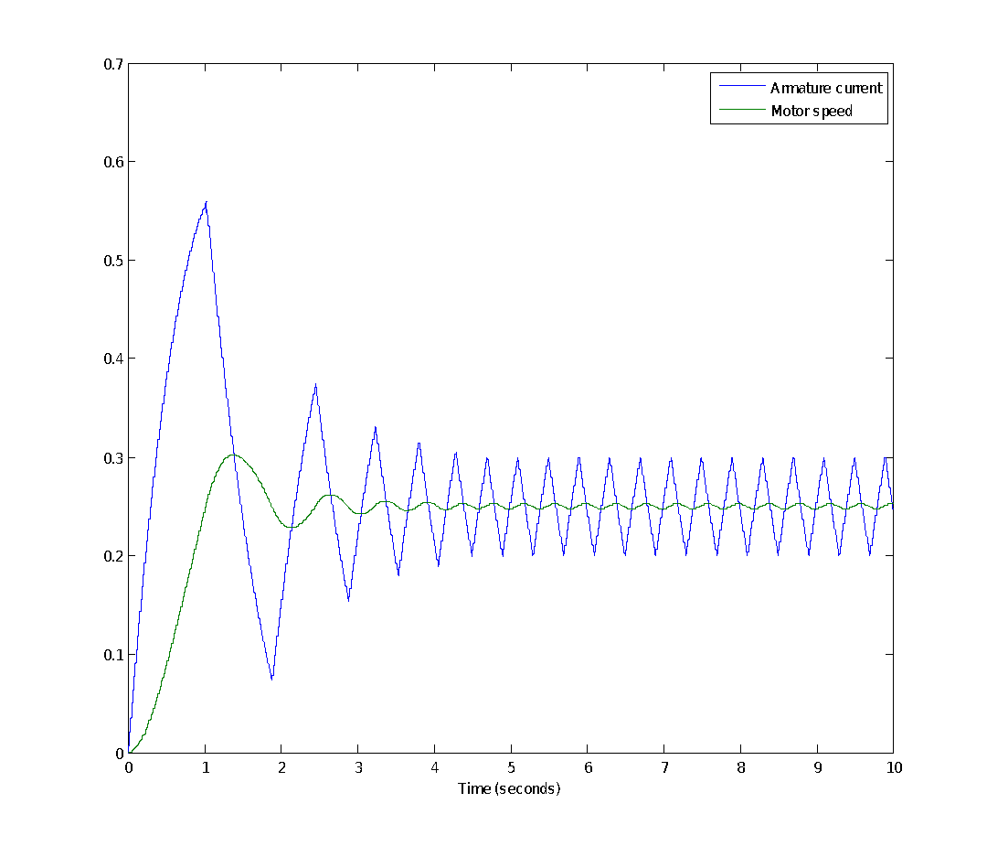
Control System: Engine Speed
Reference
r(t)
(“60rpm”)
CONTROLLER
Control input
u(t)
(electric current)
PLANT
Output x(t)
(angular velocity)

Slide 7

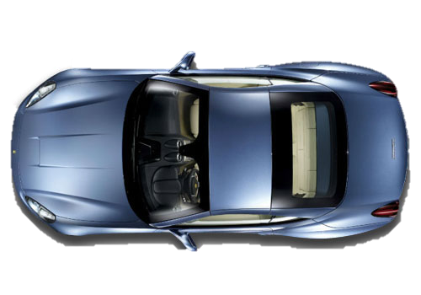
Control System: Path Tracking
Reference
r(t)
(“1m”)
CONTROLLER
Control input
u(t)
(steering rate)
d
PLANT
Output x(t)
(distance d)
Notes:
Control Objective:
Keep the car driving along the centerline
Stay parallel to the walls

Slide 8
Control System: Path Tracking
e(t)=r(t)-x(t)
CONTROLLER
r(t)
CONTROLLER
r(t)
-
u(t)
u(t)=f(e(t))
x(t)
PLANT
PLANT
x(t)
Enhancing of the control system with an feedback error e(t)

Slide 9
PID control
x

Slide 10

Porportional Control
The Steering of the car must be in proportion to Cross Track Error:
Proportional (P)- Controller
Crosstrack Error
v
Idea: the applied control input is proportional to the crosstrack-error e(t) = r(t)-x(t)
The larger the current error e(t), the larger the applied input to correct it.
Control Input: u(t) = K_{p} * e(t)
Notes:
Consider the following car -> The goal is that the car drives along this line.
We can set the steering angle of the car 🡪 How would you set it? Constant Steering? Random Steering?

Slide 11

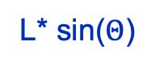
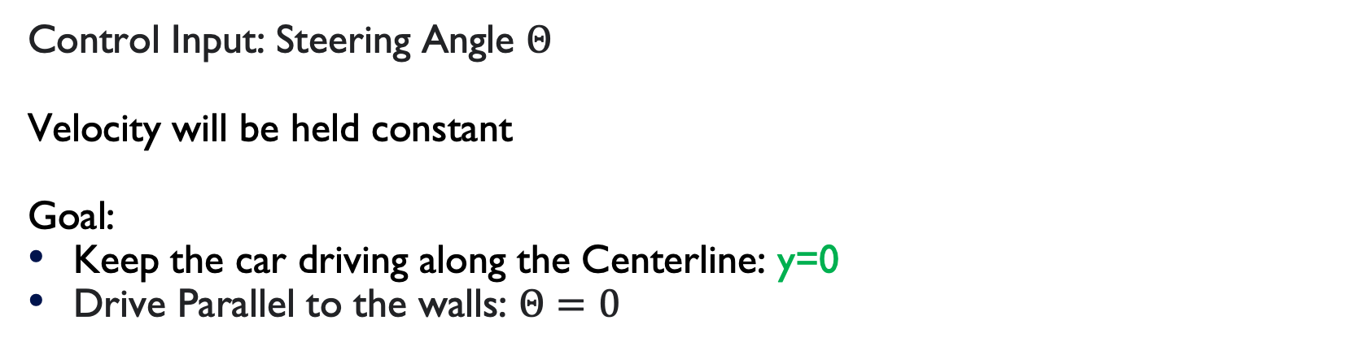
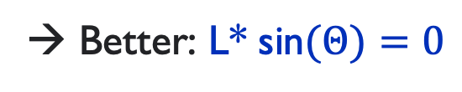
Porportional Control
y
x
L
Notes:
Better: After Driving L Meters, it is still on the Centerlin:
We will minimize the horizontal distance after Driving L Meter 🡪 Gives the car time

Slide 12
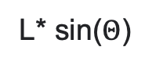
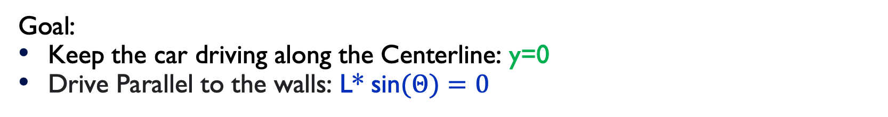
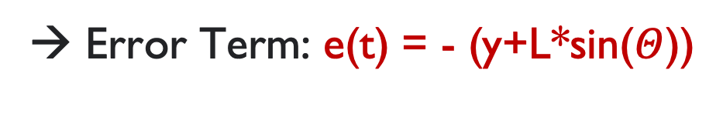
Porportional Control
y
x
L
Notes:
Y = Distance from the centerline
L*sin(theta) = Difference between the destination of driving straight and of driving at the current angle Theta
This error term gets zero:
When the car is driving on the centerline
When the car is aligned with the walls

Slide 13

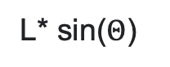
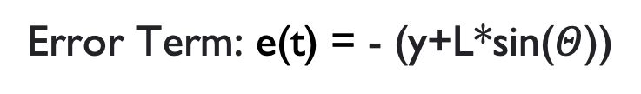
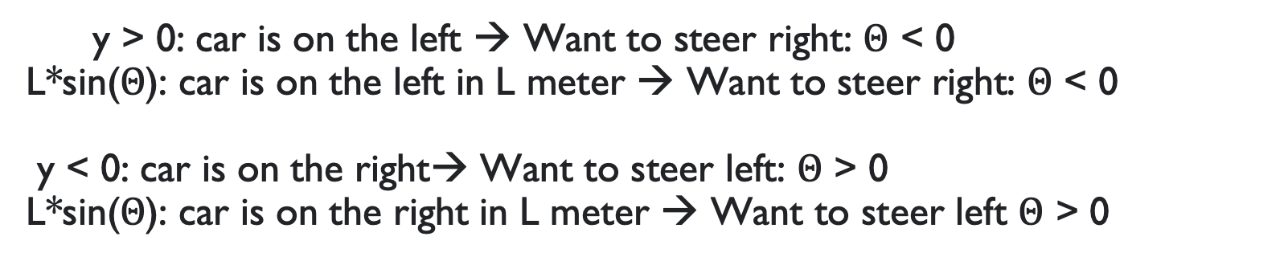
Porportional Control
y
x
L
Notes:
Simple,

Slide 14
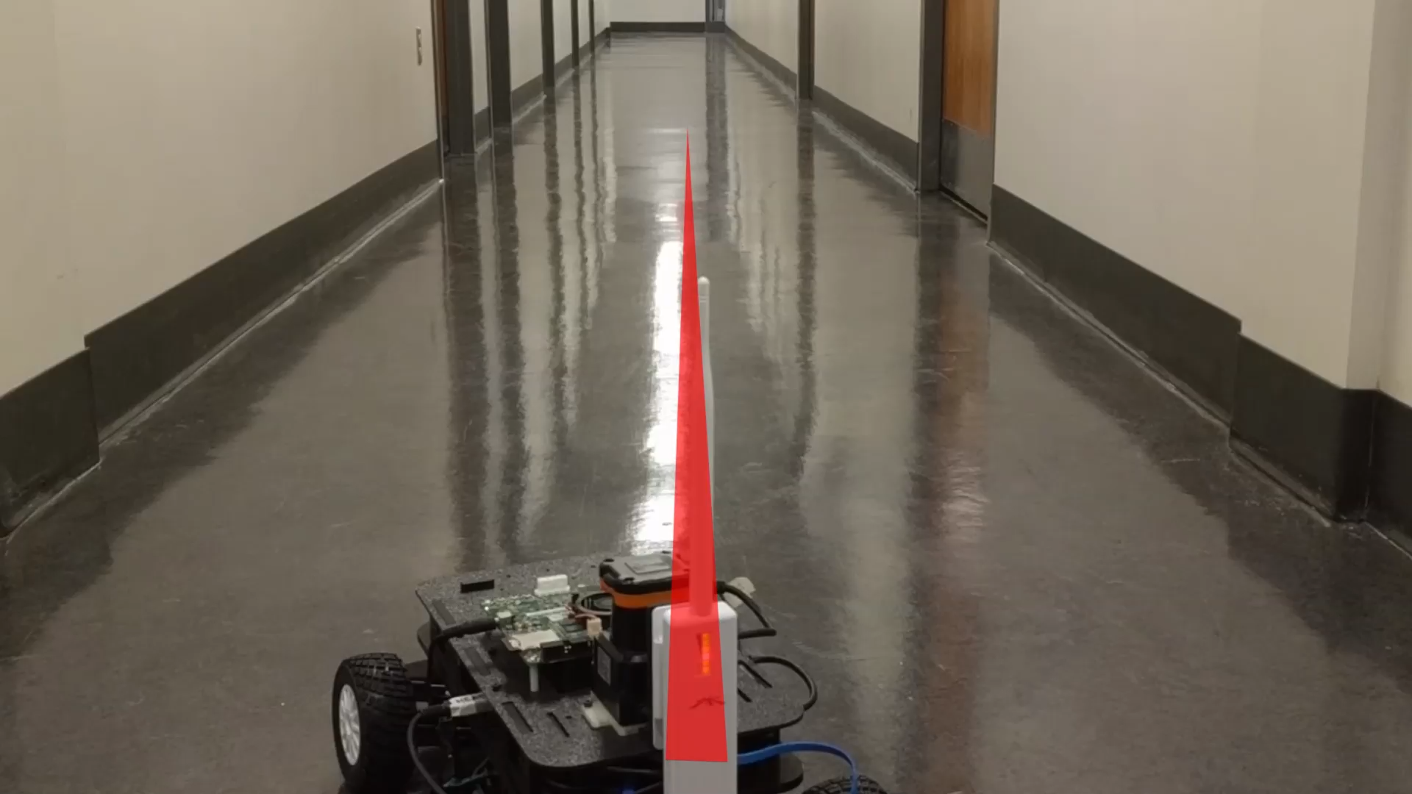
Kp = 14
Notes:
We will overshoot with this algorithm really easy -> The car will oszilate around the centerline
We need to tune this paramter so it works out fine

Slide 15
Derivative Control
y
x
By modifying the control parameter, the car might oscillate around the centerline
We need to avoid the overshoot of the car and we might to react quickly
We enhance the P-Controller with a Derivate (D) part: PD-Controller
Notes:
GOOD
Controllers improve the steady-state accuracy by decreasing the steady state error. Steady-state error is defined as the difference between the input (command) and the output of a system in the limit as time goes to infinity
As the steady-state accuracy improves, the stability also improves.
Controllers also help in reducing the unwanted offsets produced by the system.
BAD
Due to the presence of these controllers, we get some offsets in the system.
Proportional controllers also increase the maximum overshoot of the system
When the car has turned enough to reduce our defined error, it wont just go shooting for the centerline only
With the new term the car will notice that is reducing the error and it becomes smaller over the time.
The car will now countersteer/ Steer up 🡪 The car is approaching the centerline more smoovly.

Slide 16
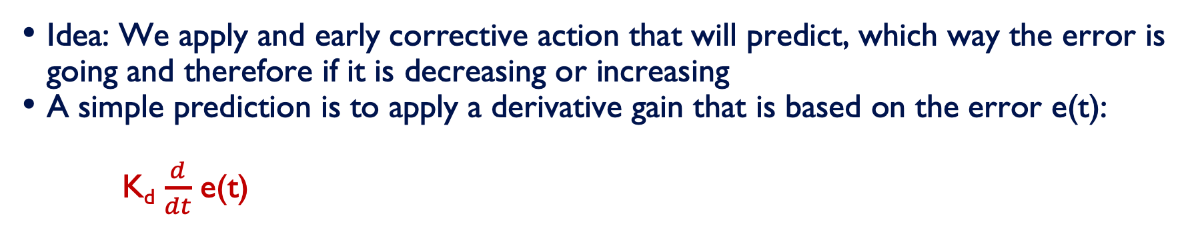
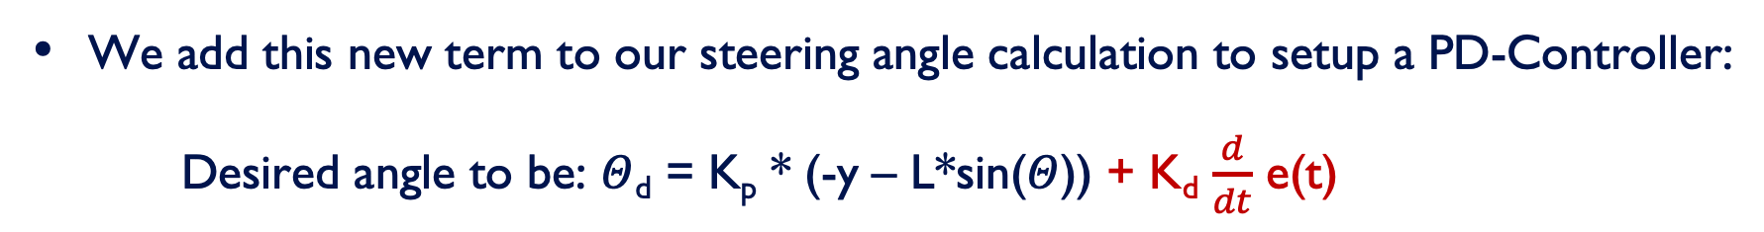
Derivative Control
Notes:
Disadvantages:
- If we have a systematic bias (e.g. a broken steering creates a steering drift) it will cause a new and big Cross Track error and will not find the centerline
- Trajectory correction takes longer because it need to smooth out

Slide 17
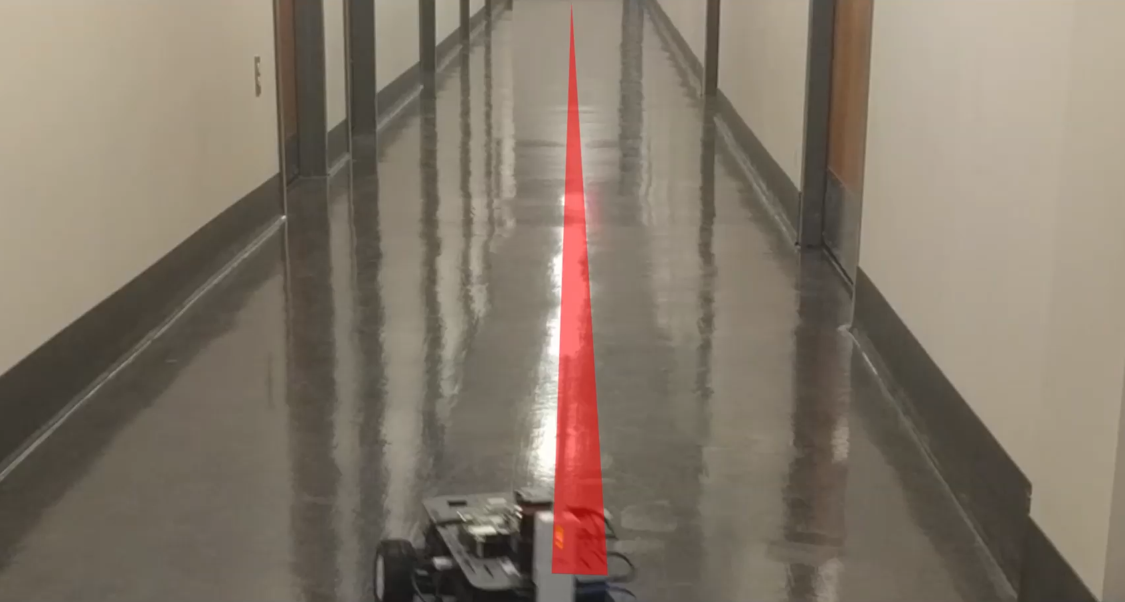
Kp = 5,
Kd = 0.09
Notes:
K_{p} = 5
K_{i} = 0
K_{d} = 0.09

Slide 18
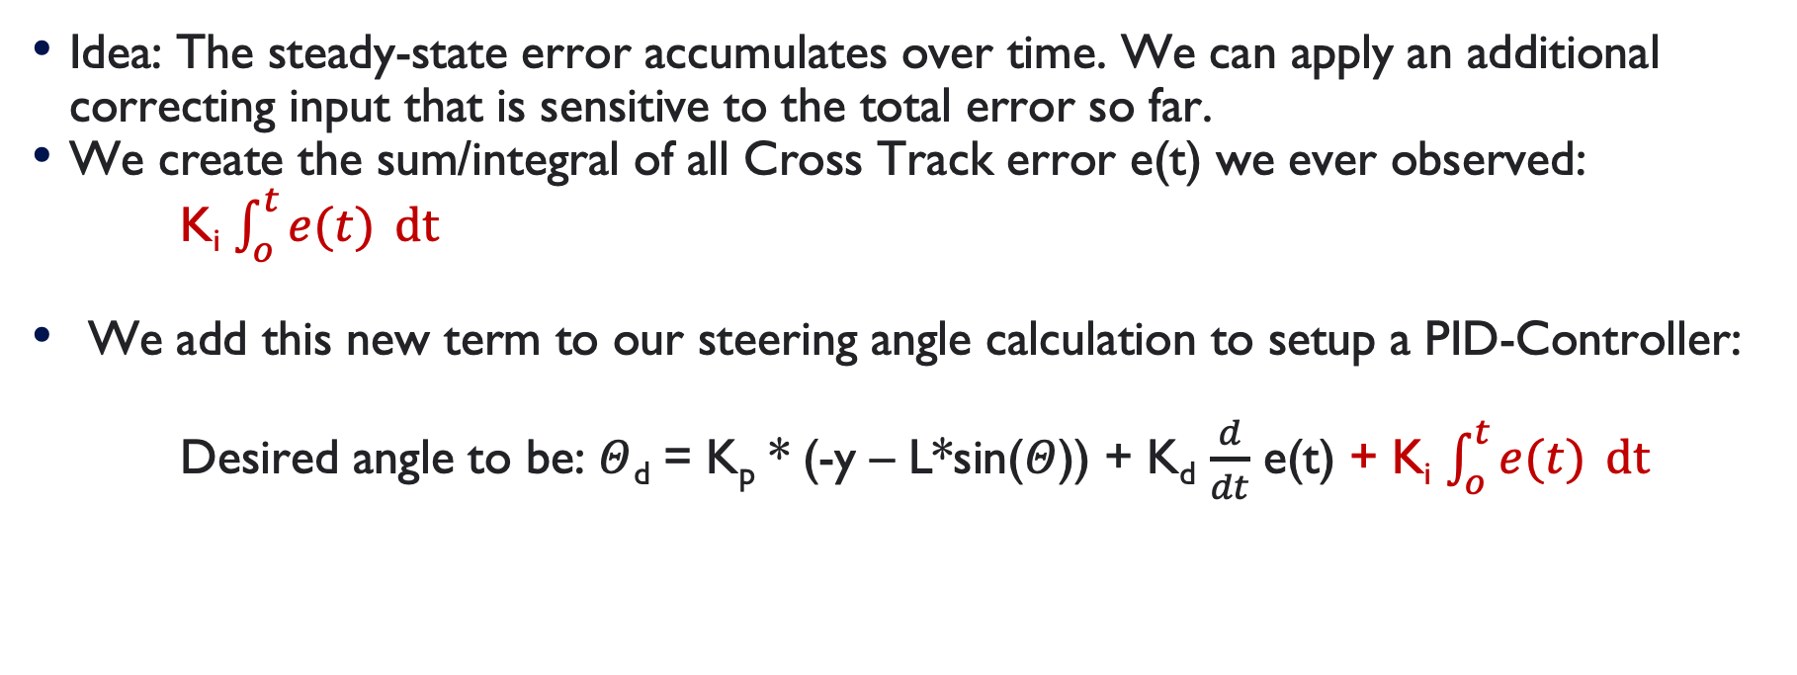
Integral control
Notes:
Imagine: If you drive a car and you normal steering mode leads you a trajectory away from the goal. Then You normale realize for a specific period of time, you cant get closer -> You will steer more and adjust to the bias.
What do you need for that? You need a sustained situation of large error -> That means: Measured the integral of the Cross Track Error over the time

Slide 19
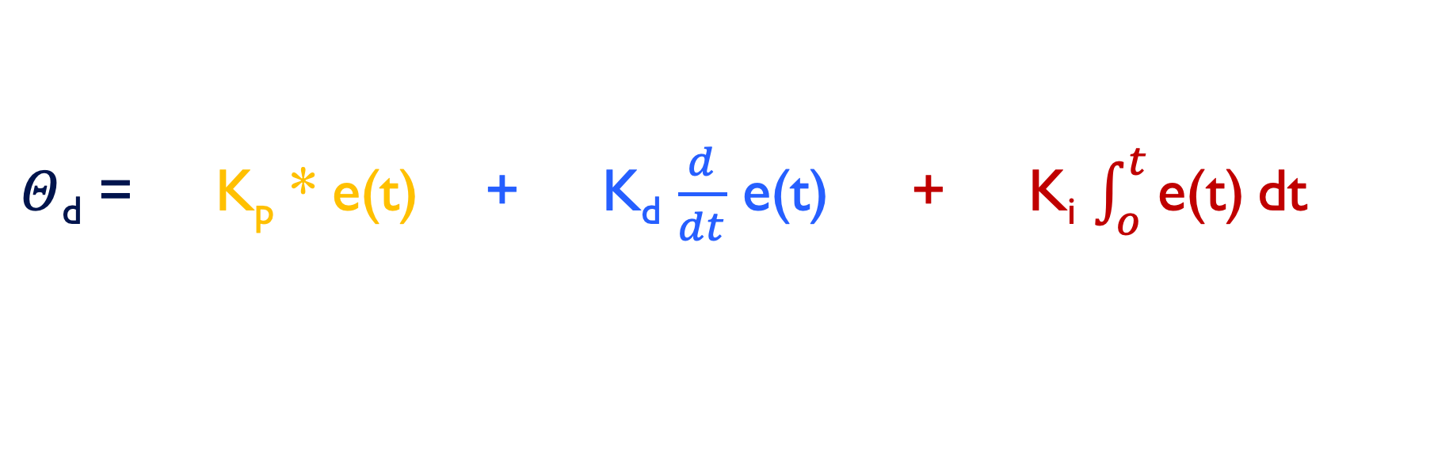
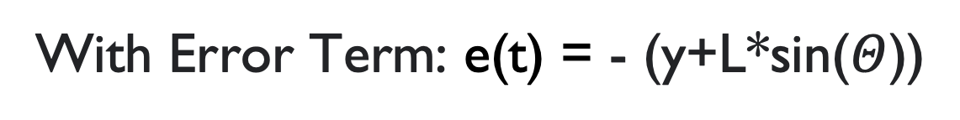
PID Controller
P Proportional
D Differential
I Integral
Notes:
A proportional–integral–derivative controller (PID controller or three-term controller) is a control loop mechanism employing feedback that is widely used in industrial control systems and a variety of other applications requiring continuously modulated control.
A PID controller continuously calculates an error value {\displaystyle e(t)} as the difference between a desired setpoint (SP) and a measured process variable (PV) and applies a correction based on proportional, integral, and derivative terms (denoted P, I, and D respectively), hence the name.

Slide 20
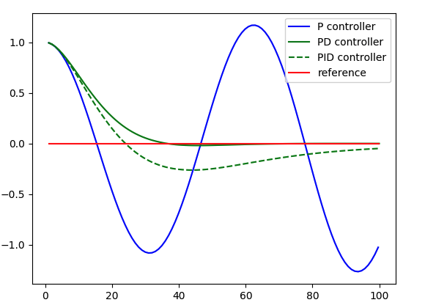
PID Controller

Slide 21
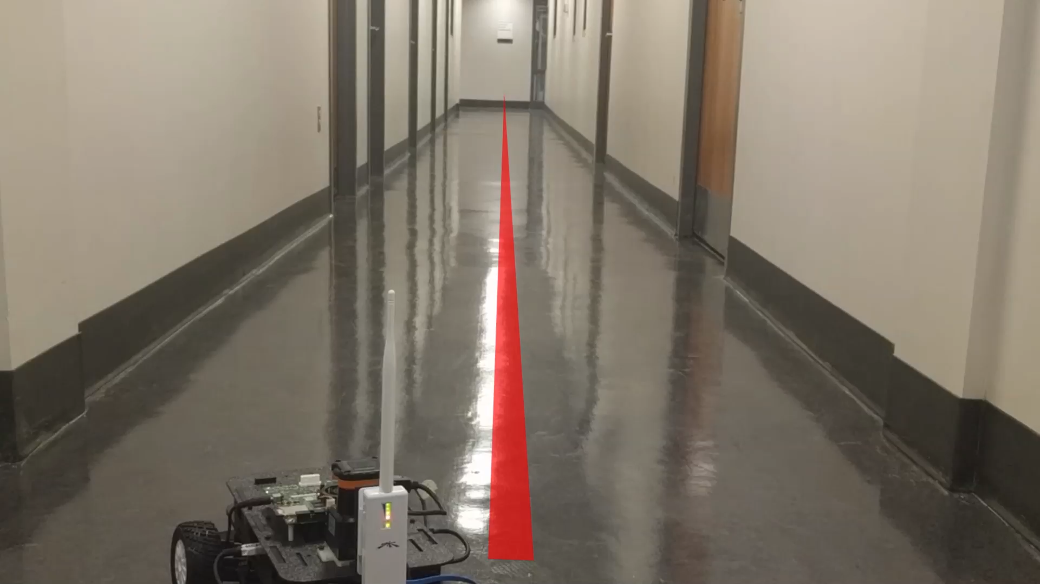
Kp = 14, Ki = 0,
Kd = 0.09
Notes:
The car starts of center with the direction to the left
The car starts and corrects very fast withouth much overcorrection -> The overcorrection decreased in comparison to the first video.

Slide 22
PID Tuning
PID Tuning: How do we find good control gains K_{p}, K_{i}, K_{d} ?
PID Tuning needs experience and hands on tuning with experiments to evaluate the tuning
Depends on the plant: what it can tolerate, what’s dangerous and what’s ok
Depends on the desired performance characteristics: low steady-state error, quick settling time…
Heuristics: Some heuristics more popular than others (e.g., Ziegler-Nichols)
Use Optimization Algorithm

Slide 23
The Laplace Transform
x

Slide 24
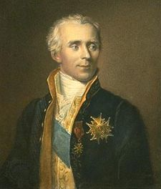
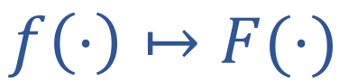
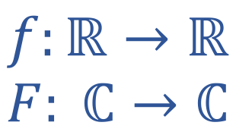
The Laplace Transform
Pierre Simon, Marquis de
The Laplace Transform
Notes:
In mathematics, the Laplace transform, named after its inventor Pierre-Simon Laplace (/ləˈplɑːs/), is an integral transform that converts a function of a real variable t}(often time) to a function of a complex variable s (complex frequency).

Slide 25
The Laplace Transform
Many dynamical systems are modeled using Ordinary Differential Equations (ODEs)
To predict the system’s behavior, we must solve these ODEs
The Laplace Transform provides a relatively easy way to solve ODEs by the formal rules of algebra
Notes:
In practice, however, one has to deal with systems that one does not know in principle and whose properties should first be measured.

Slide 26
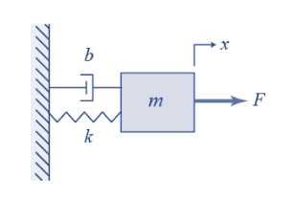
Example
As we know, the dynamic equation of the mass-spring-damper system is:
𝑚𝑥′′+𝑏𝑥′+𝑘𝑥=𝐹, given initial state 𝑥(0) = 0
Solving this differential equation in the time domain is very difficult
We want to solve this differential equation like solving an algebraic problem
Laplace: We can transform this system from the time domain to the frequency domain
Notes:
Algebraic Problem: Polynomials

Slide 27
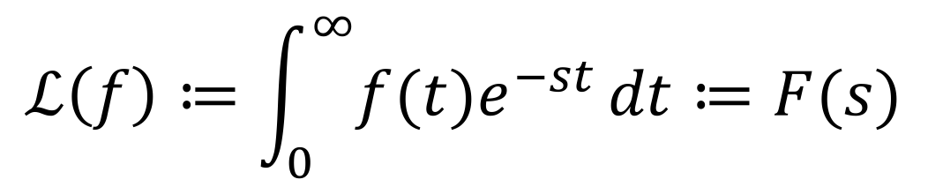
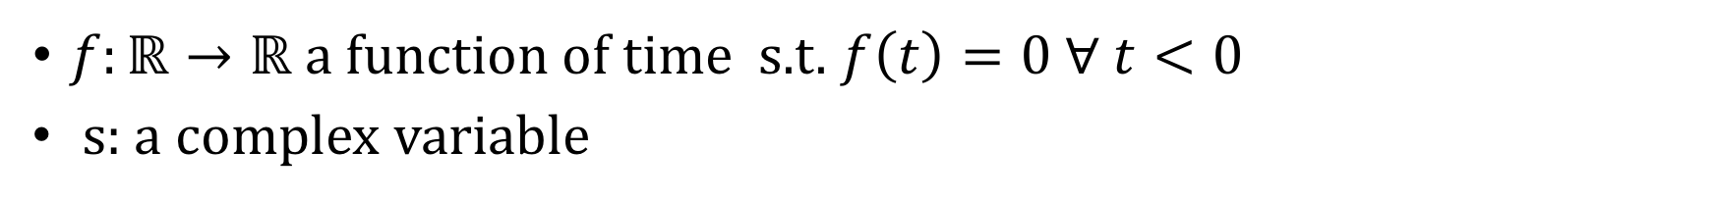
The Laplace Transform
We can use the Laplace integral :
to transfer the time domain t to the frequency domain s.
Where
Notes:
s is a complex number. It should be clear that what we use is the one-sided Laplace transform which corresponds to t≥0(all non-negative time).
The Laplace transformation takes the causality of the system into account, since it only starts at the time t = 0. It is capable of being used for most of the Reel
signals f(t), which are plotted over the time t and for the most common differential equations to calculate a reversibly unique image function F (s).

Slide 28
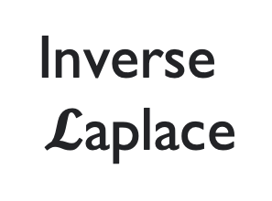
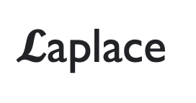

The Laplace Transform
Time Domain
x(t) y(t) = h(t) * x(t)
h(t)
X(s) Y(s) = H(s) * X(s)
H(s)
Frequency Domain
Notes:
Input x(t)
Plant/Function – Transfer Function
Output y(t)

Slide 29
Laplace Transform Properties
The main properties of Laplace Transform can be summarized with the following:
Linearity
First shifting Theorem
Change of scale property
Differentiation
Integration
Time Shifting
Product
Final Value Theorem

Slide 30
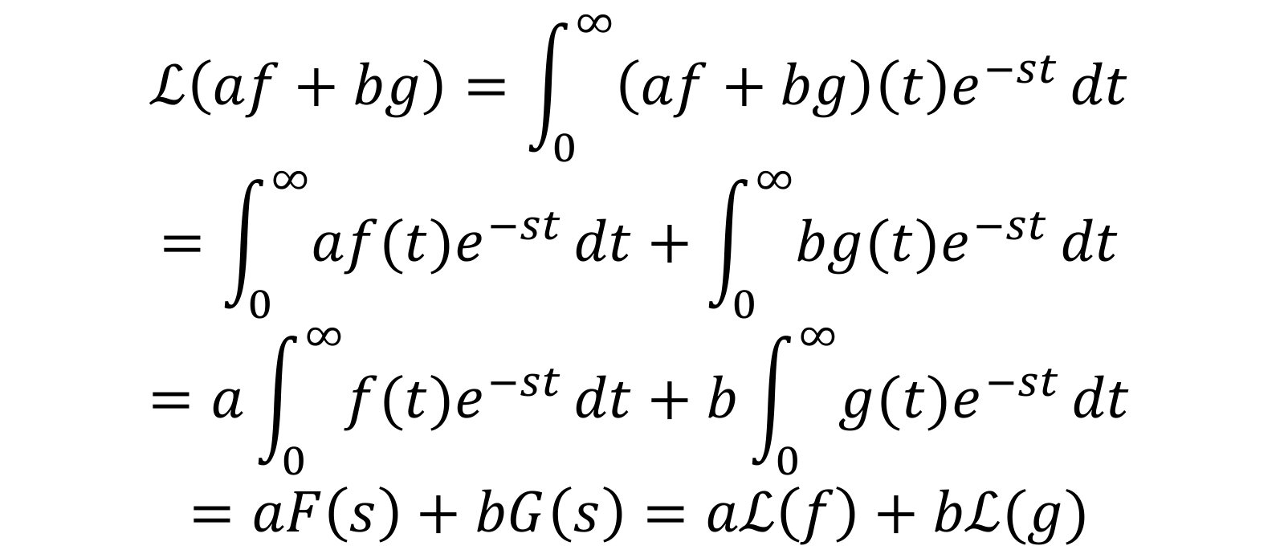
Laplace Transform Properties: Linearity
Linearity: Let a, b be constants. f(t), g(t) be the functions of time t, then
Proof:

Slide 31
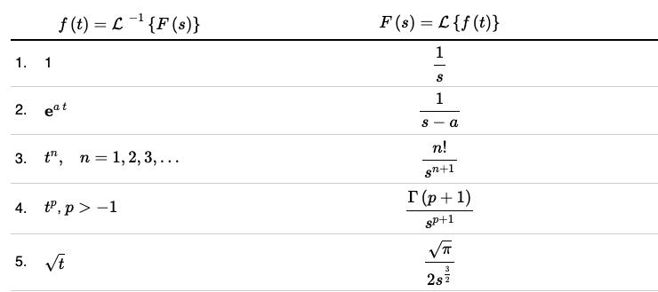
Laplace Transform Table
There is always a table that is available to the engineer that contains information on the Laplace transforms.

Slide 32
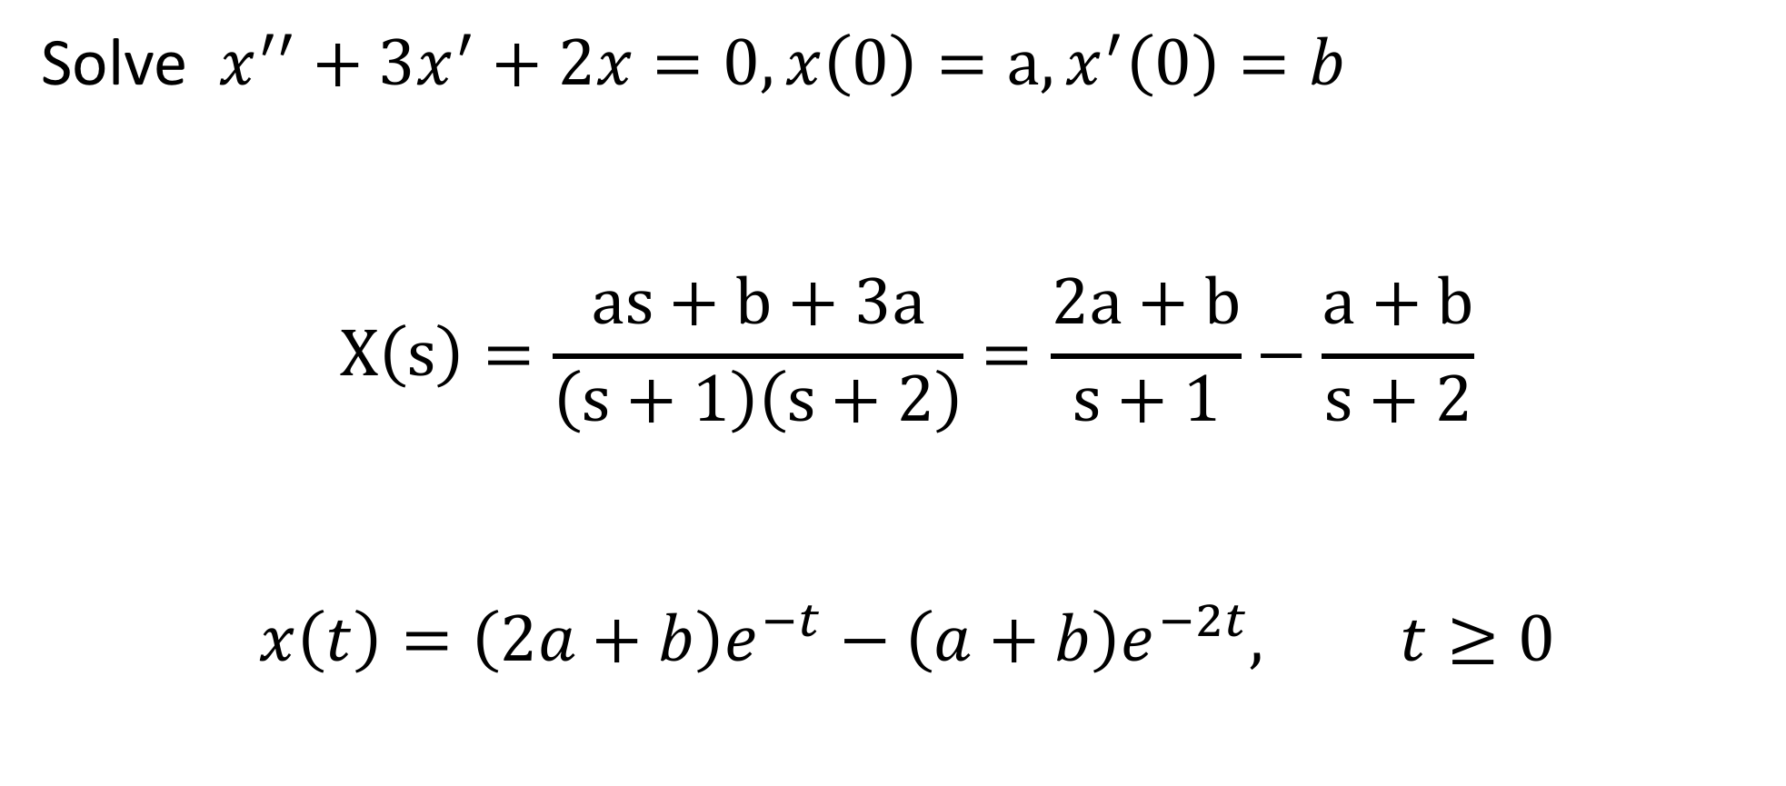
Laplace Transform Example
More Information about the The Laplace Transform can be found here: https://www.khanacademy.org/math/differential-equations/laplace-transform

Slide 33
Laplace for Control Systems
e(t)=r(t)-x(t)
CONTROLLER
e(t)
-
CLOSED LOOP
(CONTROLLER + PLANT)
r(t)
r(t)
-
u(t)=f(e(t))
PLANT
x(t)
x(t)
By transferring the control system from time domain to frequecncy domain, we can easily see if the system is stable or not
Notes:
The key advantage of transfer functions is in their compactness, which makes them suitable for frequency-domain analysis and stability studies.
However, the transfer function approach suffers from neglecting the initial conditions. Not only does state-space representation serve as an alternative to transfer functions, but also it is not limited to linear and time-invariant systems and it has the following advantages:

Slide 34
Laplace for Control Systems
e(t)=r(t)-x(t)
CONTROLLER
e(t)
-
H(s)
r(t)
r(t)
-
u(t)=f(e(t))
PLANT
x(t)
x(t)
Creating a Transfer Function
Notes:
Control loops consist of several interconnected blocks,
We combine all these Blocks in one function: Controller + Plant
By Transfering it into the frequency domain, we can describe the whole System with ONE
transfer function.
For the interconnection of these blocks there are the calculation rules applied you saw before.

Slide 35
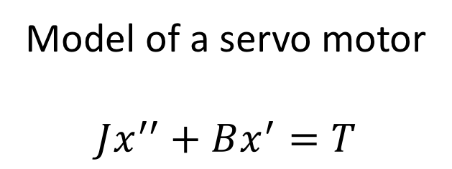
Example: Model of Servo Motor
B (damping)
e(t)
T
r(t)
Desired position
-
K
J
x(t)
Actual position
Proportional
gain
Inertia
Notes:
Here you can see now the model of the complete system in the time domain that includes both plant and the controller

Slide 36
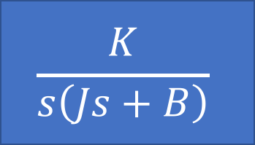
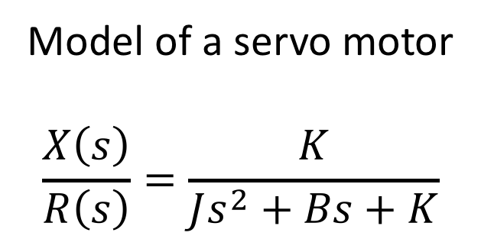
Example: Model of Servo Motor - Laplace
R(s)
-
X(s)
Notes:
Here we see now the example of the Motor System transferred to the frequency domain that includes both Motor model and controller

Slide 37
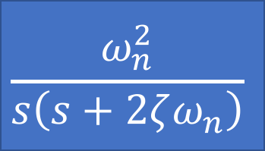
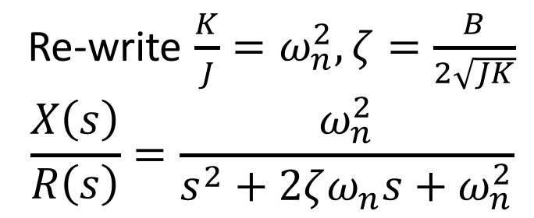
Example: Model of Servo Motor - Laplace
R(s)
-
X(s)

Slide 38
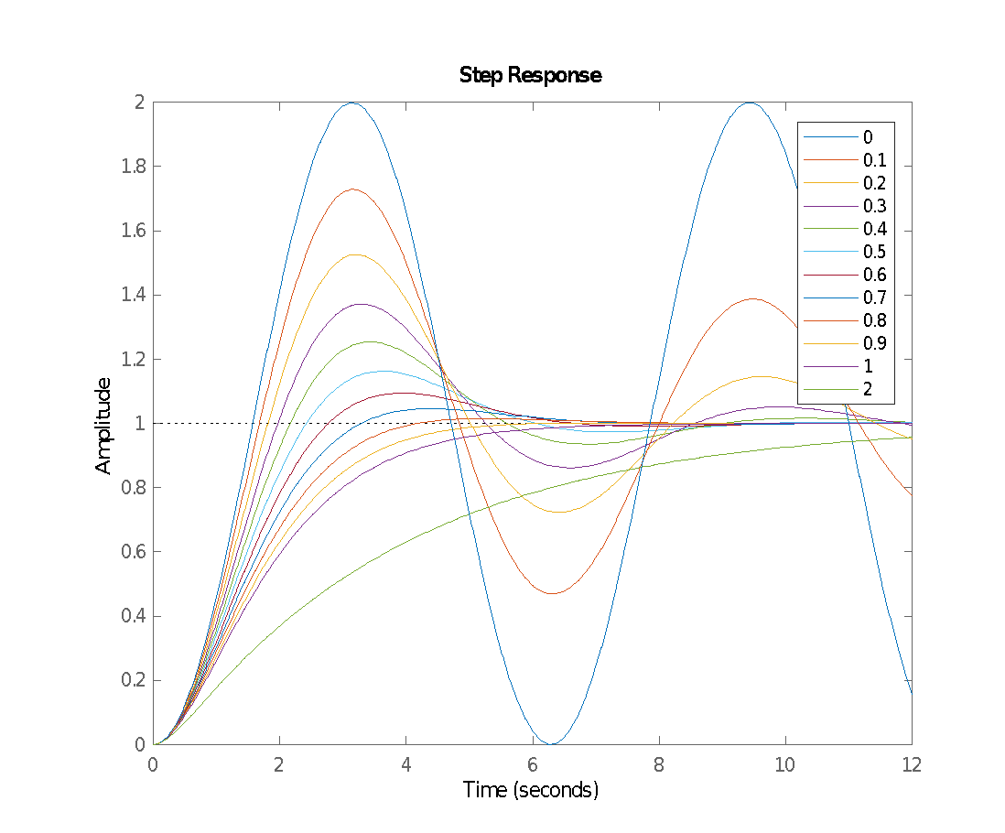
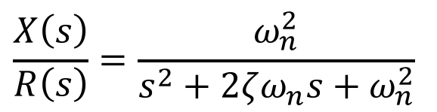
The Laplace Transform
Notes:
The acquisition of the properties can be done by recording the step and impulse response or by measuring the frequency response.
Step response, impulse response, frequency response and ODE have a similar information content, because they all contain the description of the system in a different form.

Slide 39
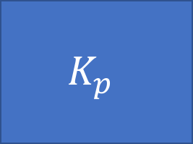
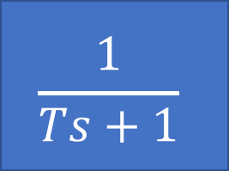
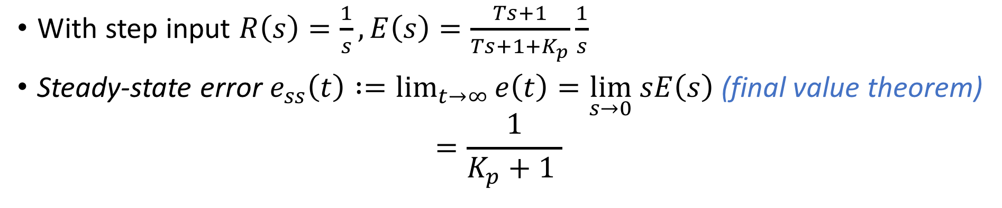
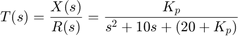
P-Controller: Transfer Function
E(s)
R(s)
-
X(s)
Proportional
gain
Plant
Notes:
Proportional controller (Kp) reduces the rise time, increases the overshoot, and reduces the steady-state error.
The Proportional Controller in the Laplace Domain is no more or less the error E(s) multiplied with the factor Kp
The closed-loop transfer function of the above system with a proportional controller is T(s)
https://www.tutorialspoint.com/control_systems/control_systems_controllers.htm

Slide 40
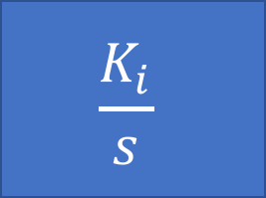
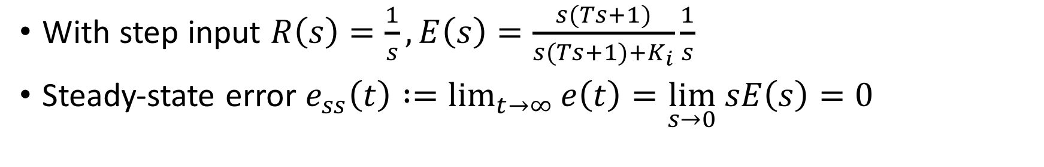
I-Controller: Transfer Function
E(s)
R(s)
-
X(s)
Integral
gain
Plant

Slide 41
Controller Tuning
Stability: The closed control loop should be stable. There are, however, configurations in which the controlled system is unstable and the controller itself also shows unstable behavior. Only the closed control loop shows the desired stability.
Following The Reference: In a closed control loop the controlled variable x should follow the reference w asymptotically, i.e. the difference between the two variables should become zero in the steady state. A permanent control difference is usually undesirable.
Transient response: The way in which the controlled variable x follows the reference w is also referred to as command response. The relationship between the controlled variable x and an additional disturbance variable z is called "disturbance response": A too fast transient response, which is achieved by large controller amplifications, leads to large values of the manipulated variable u. Here it is important to maintain the proportionality of the means: You cannot turn a lame duck into a racing car with the help of the controller!
Notes:
A system is said to be stable, if its output is under control. Otherwise, it is said to be unstable. A stable system produces a bounded output for a given bounded input.

Slide 42
Applications
x

Slide 43
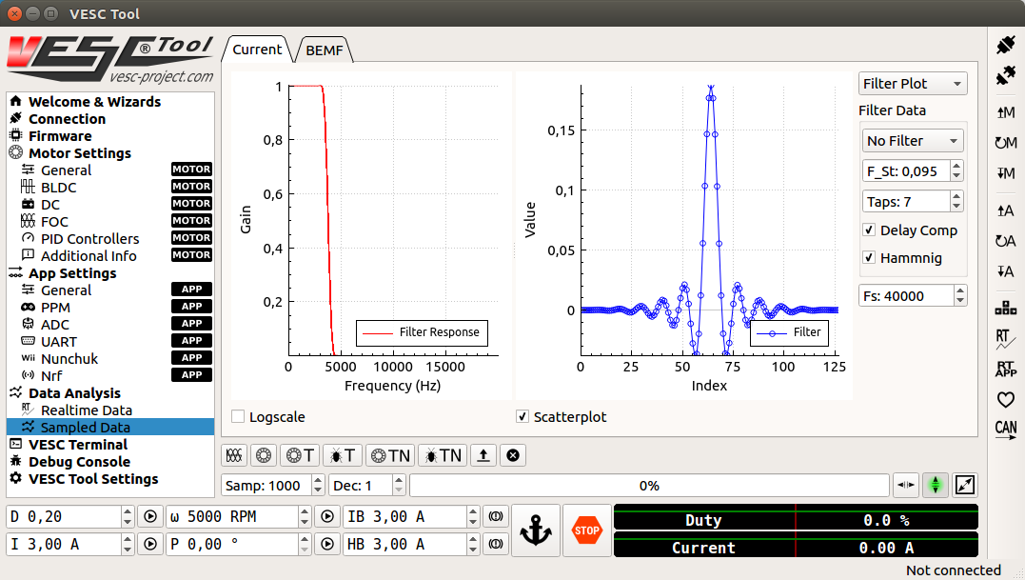
PID-Tuning: VESC Controller
Usage of the VESC Tool v2.03: https://vesc-project.com/vesc_tool
Notes:
After firmware update, Select Load Motor Configuration XML from the drop down menu and select the provided XML file from here . After the XML is uploaded, click on the Write Motor Configuration button (the button with a down arrow and the letter M) on the right side of the screen to apply the motor configuration. Note that in the future, you’ll have to press this button whenever you make a change in motor configuration.

Slide 44

PID-Tuning: VESC Controller
Notes:
Now you can start tuning the speed PID controller. To see the RPM response from the motor, navigate to the Realtime Data tab under Data Analysis on the left. Click Stream Realtime Data button on the right (the button with letters RT), and navigate to the RPM tab on the top of the screen. You should see RPM data streaming now.

Slide 45

PID-Tuning: VESC Controller
Notes:
To create a step response for the motor, you can set a target RPM at the bottom of the screen (values between 2000 - 10000 RPM). Click the play button next to the text box to start the motor. Note that the motor will spin, so make sure the wheels of your vehicle are clear from objects. Click the Anchor or STOP button to stop the motor.
ATTENTION: You want to look for a clean step response that has a quick rise time and zero to very little steady state error

Slide 46

PID-Tuning: VESC Controller
Notes:
. Adjust the gains accordingly by navigating to the PID Controllers tab under Motor Settings on the left, and change the Speed Controller gains. General rules of tuning PID gains apply. If you’re seeing a lot of oscillations, try changing the Speed PID Kd Filter.

